Slide 1
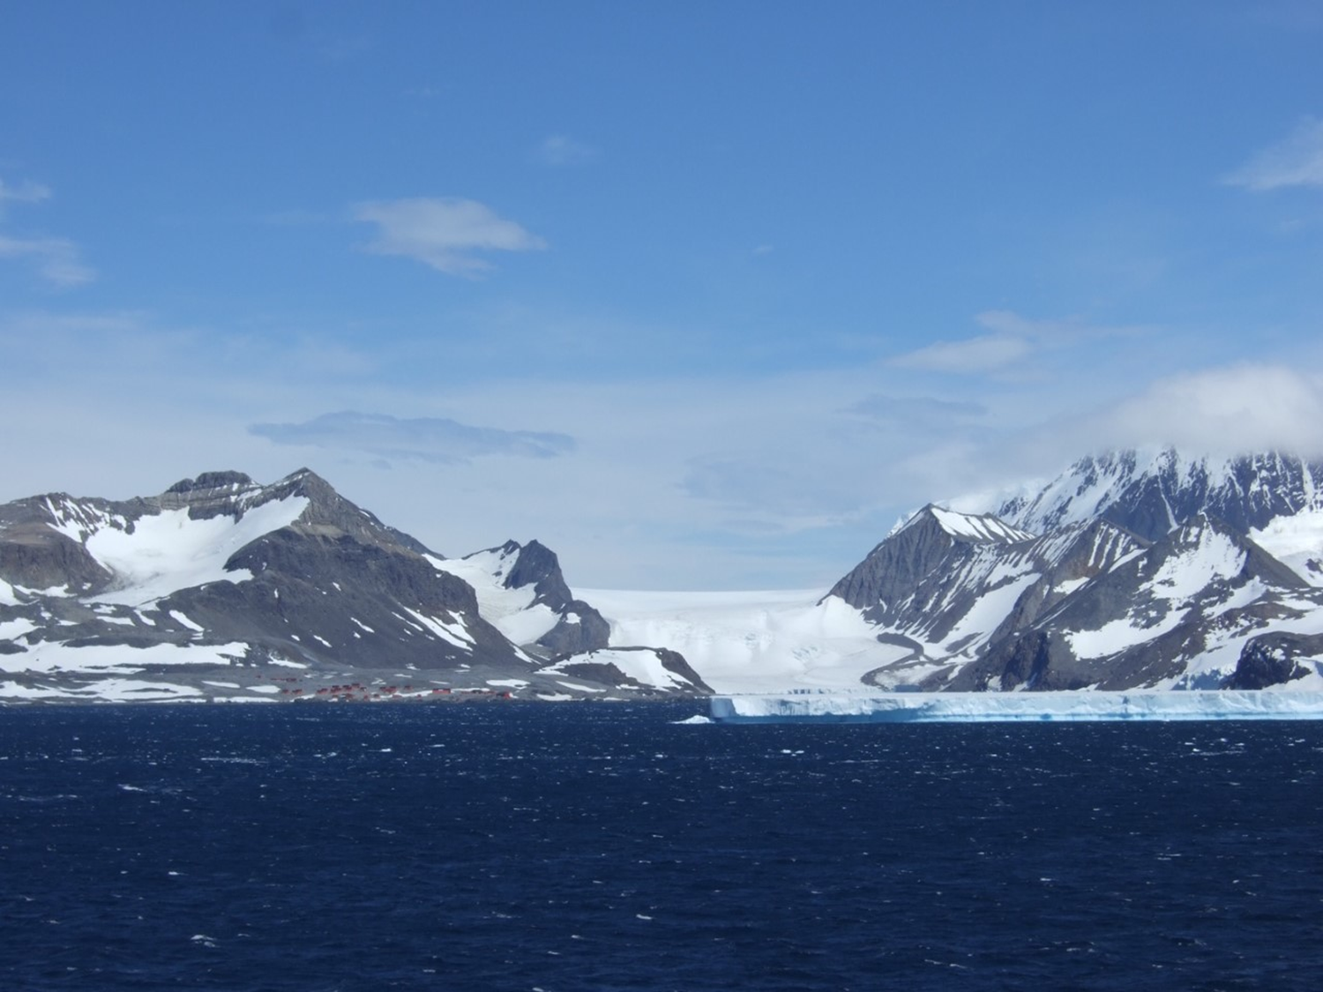
The Polar Regions

Slide 2
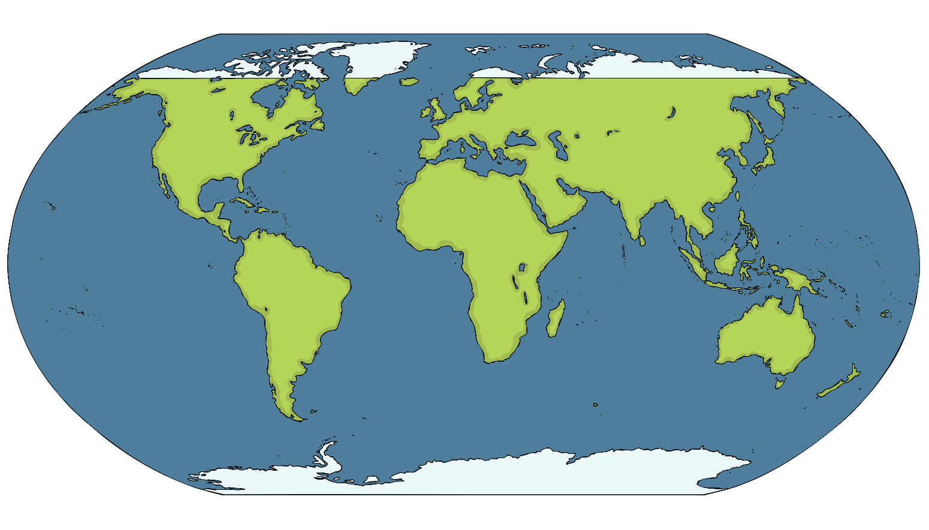
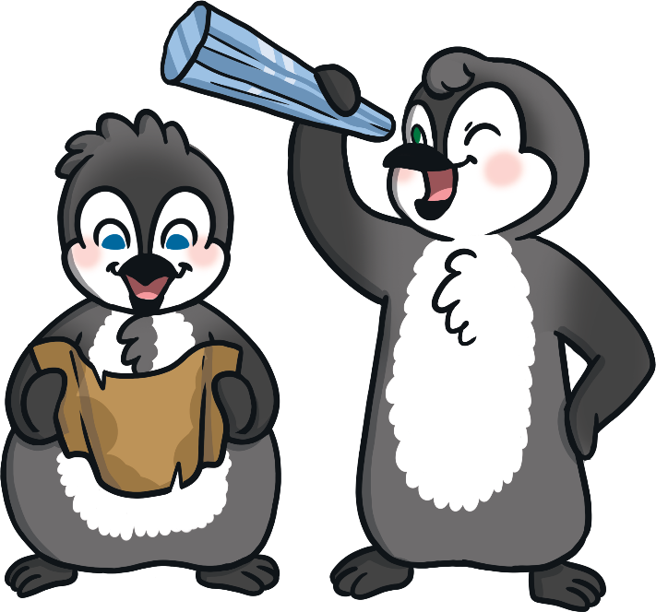
Where Are the Polar Regions?
The Arctic
(North Pole)
Antarctica
(South Pole)
Do you recognise any other places on the map? Can you name the continents?

Slide 3
Today we are learning about the climate in the Arctic and Antarctica.
Climate – what the weather is like usually

Slide 4
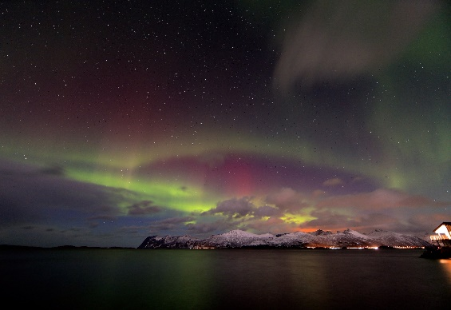
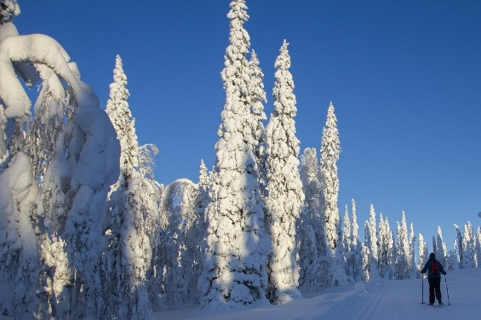
Climate in the Arctic
The Arctic has long, cold winters and short, cool summers. The winters last for about 8 months.
In the winter, the sun is so far away from the Arctic that it doesn’t rise at all. This means it can be cold and dark for months.
The temperature in the Arctic can be as low as -34ºC in the winter.
The Arctic is not as cold as the Antarctic as the ocean warms the air a little. In some months, the northern lights can be seen.
What do you think it would be like if you didn’t see the sun for months?

Slide 5
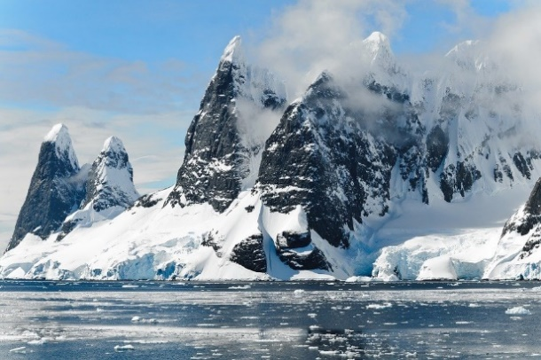
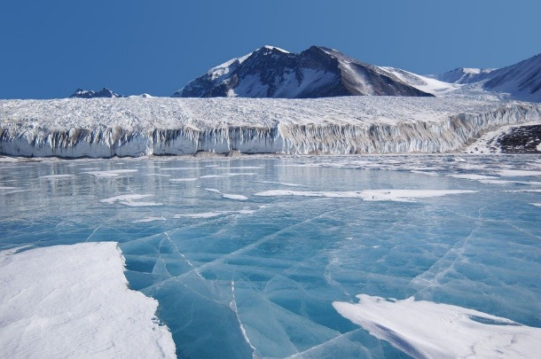
Climate in Antarctica
Antarctica is the coldest and windiest place on Earth. The lowest temperature ever recorded here was -89ºC!
Antarctica’s winter also lasts for 8 months.
Because it is so cold, over 98% of Antarctica is permanently covered in ice. The average thickness of this ice is about one mile!
Antarctica is also home to the driest place on Earth. There are places in Antarctica which haven’t had rain or snow in over 2 million years!
What do you think -89ºC would feel like?

