Slide 1
R.E. SPECIAL OBJECTS AND SYMBOLS
UNDERSTANDING SYMBOLS
LO
1.To understand what a symbol is.
2. To reflect on the meaning of symbols.

Slide 2
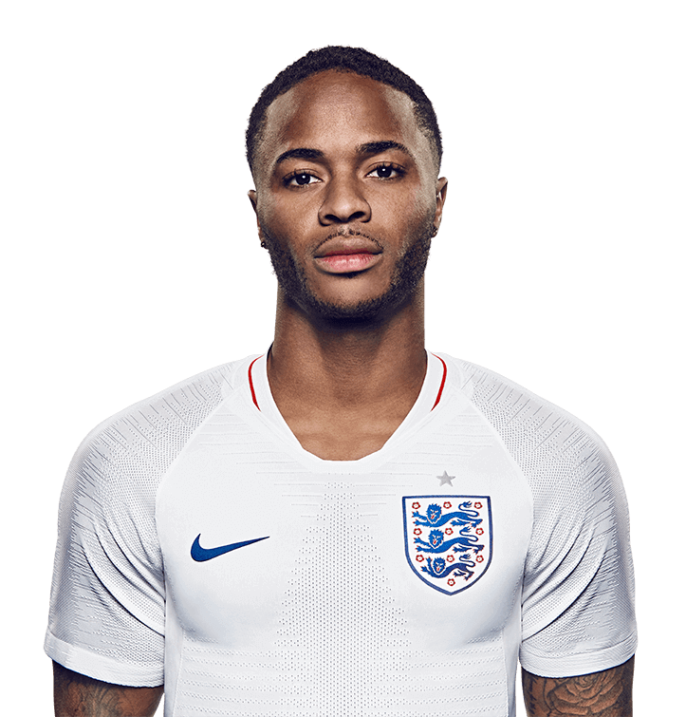
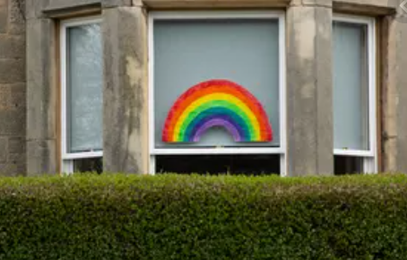
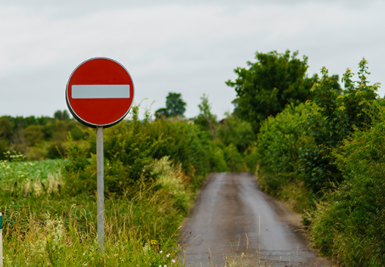
SYMBOL HUNT!
WHAT SYMBOLS CAN YOU SEE IN THE IMAGES BELOW?
-1 POINT FOR EACH SYMBOL
-2 POINTS IF YOU CAN IDENTIFY THE MEANING!

Slide 3
SYMBOL HUNT!
WHAT SYMBOLS CAN YOU SEE IN THE IMAGES BELOW?
The tick is the symbol of the sportswear brand Nike. The three lions are the symbol of the England football team. Lions are brave and strong.
The rainbow is a symbol of thanks for the NHS. Rainbows come when there is rain and sun – what might the message be?
This red symbol tells drivers ‘do not enter.’ Red is often the colour of danger or warning. With the white stripe, it grabs our attention.

Slide 4
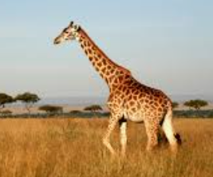
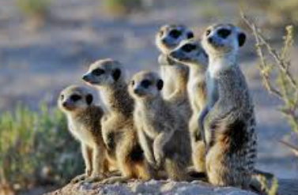
OUR OWN SYMBOLS
DISCUSS :
How could you describe yourself?
Year One -Can you think of some adjectives? Year Two - What about some similes?
WHAT YOU ARE LIKE ON THE OUTSIDE
e.g. tall like a giraffe.
WHAT ARE YOU LIKE ON THE INSIDE
e.g. a good team player, like a meerkat!

Slide 5
OUR OWN SYMBOLS
DESIGNING OUR SYMBOLS!
Create your own symbol to represent you!
In your symbol, include details about:
-What you are like on the outside
-What you are like on the inside
Think about what different colours and shapes represent. Keep your symbol simple!
See the examples on the next slides.

Slide 6
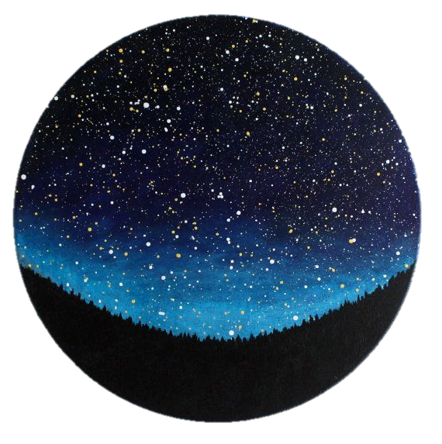
EXAMPLE SYMBOL
I used a starry sky because I want to ‘reach for the stars’ and achieve great things.
My symbol includes a panda because I am big but gentle.

Slide 7
EXAMPLE SYMBOL
I used a blue and green background because I care about planet Earth.
I used a lightbulb because I have good ideas!

Slide 8
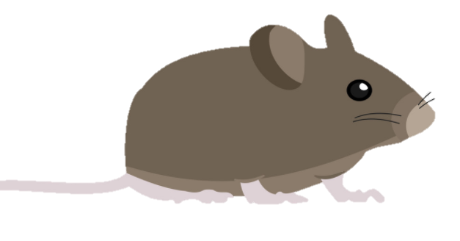
EXAMPLE SYMBOL
The background is the colours of the Indian flag. India is where I come from.
The mouse represents how small, timid and determined I am.

