Slide 1
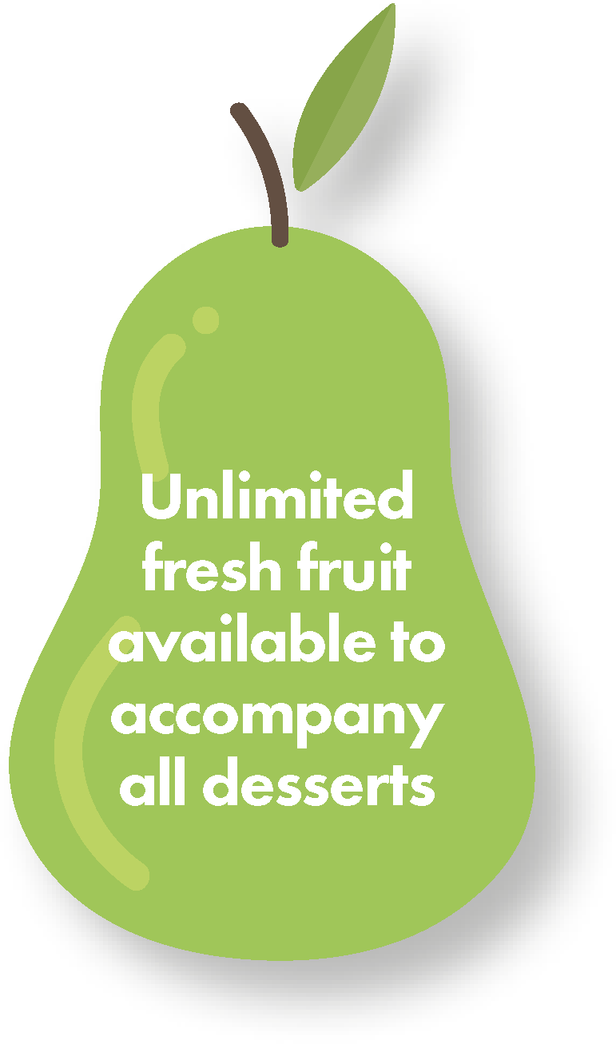
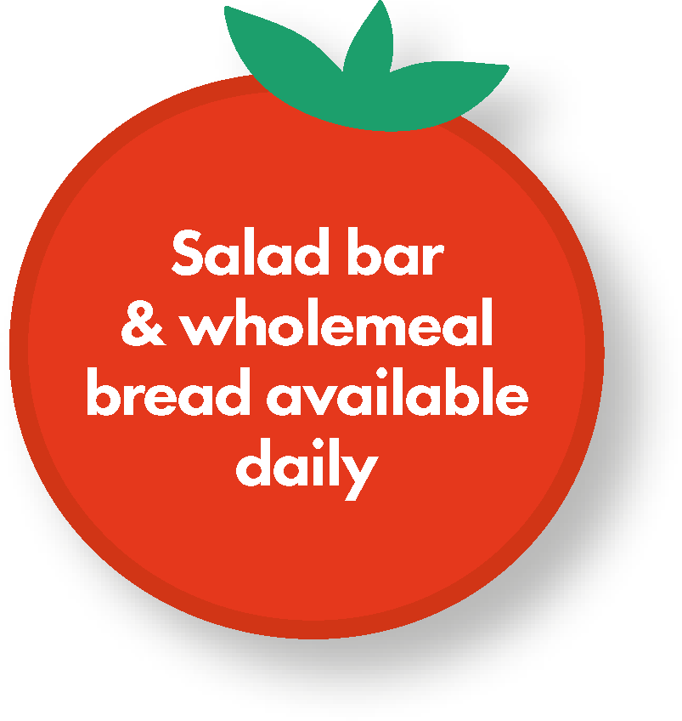
 | Week commencing: April 16th • May 7th • June 4th • June 25th • July 16th • Sept 10th • Oct 1st
 | MONDAY | TUESDAY | WEDNESDAY | THURSDAY | FRIDAY
 | Quorn meatball sub | Pork sausages and mashed potatoes with gravy | Barbecue Bar Beef burger in a bap with potato salad | Roast chicken, stuffing and gravy with crispy roast potatoes | Crispy fish fingers with chips
 | Garden peas Rainbow salad | Fresh broccoli | Corn on the cob Summer coleslaw | Carrots Green beans | Garden peas Baked beans
 | Raspberry mousse slice Fruit yoghurt Fresh fruit slices | Tutti fruity Tuesday Fruit yoghurt | Oat and raisin cookie Fruit yoghurt Fresh fruit slices | Ice cream tub with a wafer Fruit yoghurt Fresh fruit slices | Blueberry muffin Fresh fruit slices
 | Week commencing: April 23rd • May 14th • June 11th • July 2nd • July 23rd • Sept 17th • Oct 8th
 | MONDAY | TUESDAY | WEDNESDAY | THURSDAY | FRIDAY
 | Southern style burger in a bap | Buttermilk chicken with brown rice | Margarita pizza | Roast gammon and pineapple with gravy and crispy roast potatoes | Golden fish fingers with chips
 | Corn on the cob Minted garden peas | Green beans | Sweetcorn | Fresh broccoli Carrots | Garden peas Summer coleslaw
 | Waffles with ice cream and strawberry sauce Fruit yoghurt | Tutti fruity Tuesday Fruit yoghurt | Strawberry ice sponge roll Fresh fruit slices | Yoghurt bar Fresh fruit slices | Oat and raisin cookie with milk Fruit yoghurt Fresh fruit slices
 | Week commencing: April 30th • May 21st • June 18th • July 9th • Sept 3rd • Sept 24th • Oct 15th
 | MONDAY | TUESDAY | WEDNESDAY | THURSDAY | FRIDAY
 | Margarita pizza with pasta salad | All day brunch Omelette, sausage, bacon and diced potatoes | Chicken and barbecue sauce with rice | Roast turkey, stuffing and gravy with crispy roast potatoes | Crispy bubble fish fillet and chips
 | Coleslaw | Baked beans Grilled tomatoes | Mixed rainbow salad Garden peas | Fresh broccoli Carrots | Sweetcorn Tomato spaghetti hoops
 | Chocolate mousse slice Fruit yoghurt | Tutti fruity Tuesday Fruit yoghurt | Jelly and ice cream Fresh fruit slices | Oat and raisin cookie with a milkshake Fruit yoghurt Fresh fruit slices | Apple and berry crumble slice with ice cream Fresh fruit slices Fruit yoghurt
Salad bar available subject to the style of service. Some menus or items on the menu are subject to change. A vegetarian option is available each day if required. All desserts are suitable for vegetarians.

